Slide 1
Backstage
And open platform for building developer portals.

Slide 2

My Profile
Hi, everyone!
I'm Hieu, a self-motivated, creative and hard-working DevOps engineer with seven-year experience with the abilities:
• Ability to automate routine processes using Python, Bash
• Good hands-on knowledge of Source Code Management (Version Control System) tools like Git
• Proficient in developing Continuous Integration/ Delivery pipelines
• Experience with automation/ integration tools like Jenkins, Gitlab-Ci, Git Hub
• Knowledge of major cloud service providers, like AWS, GCP, Azure
• Hands-on knowledge of software containerization platforms like Docker,Kubernetes

Slide 3
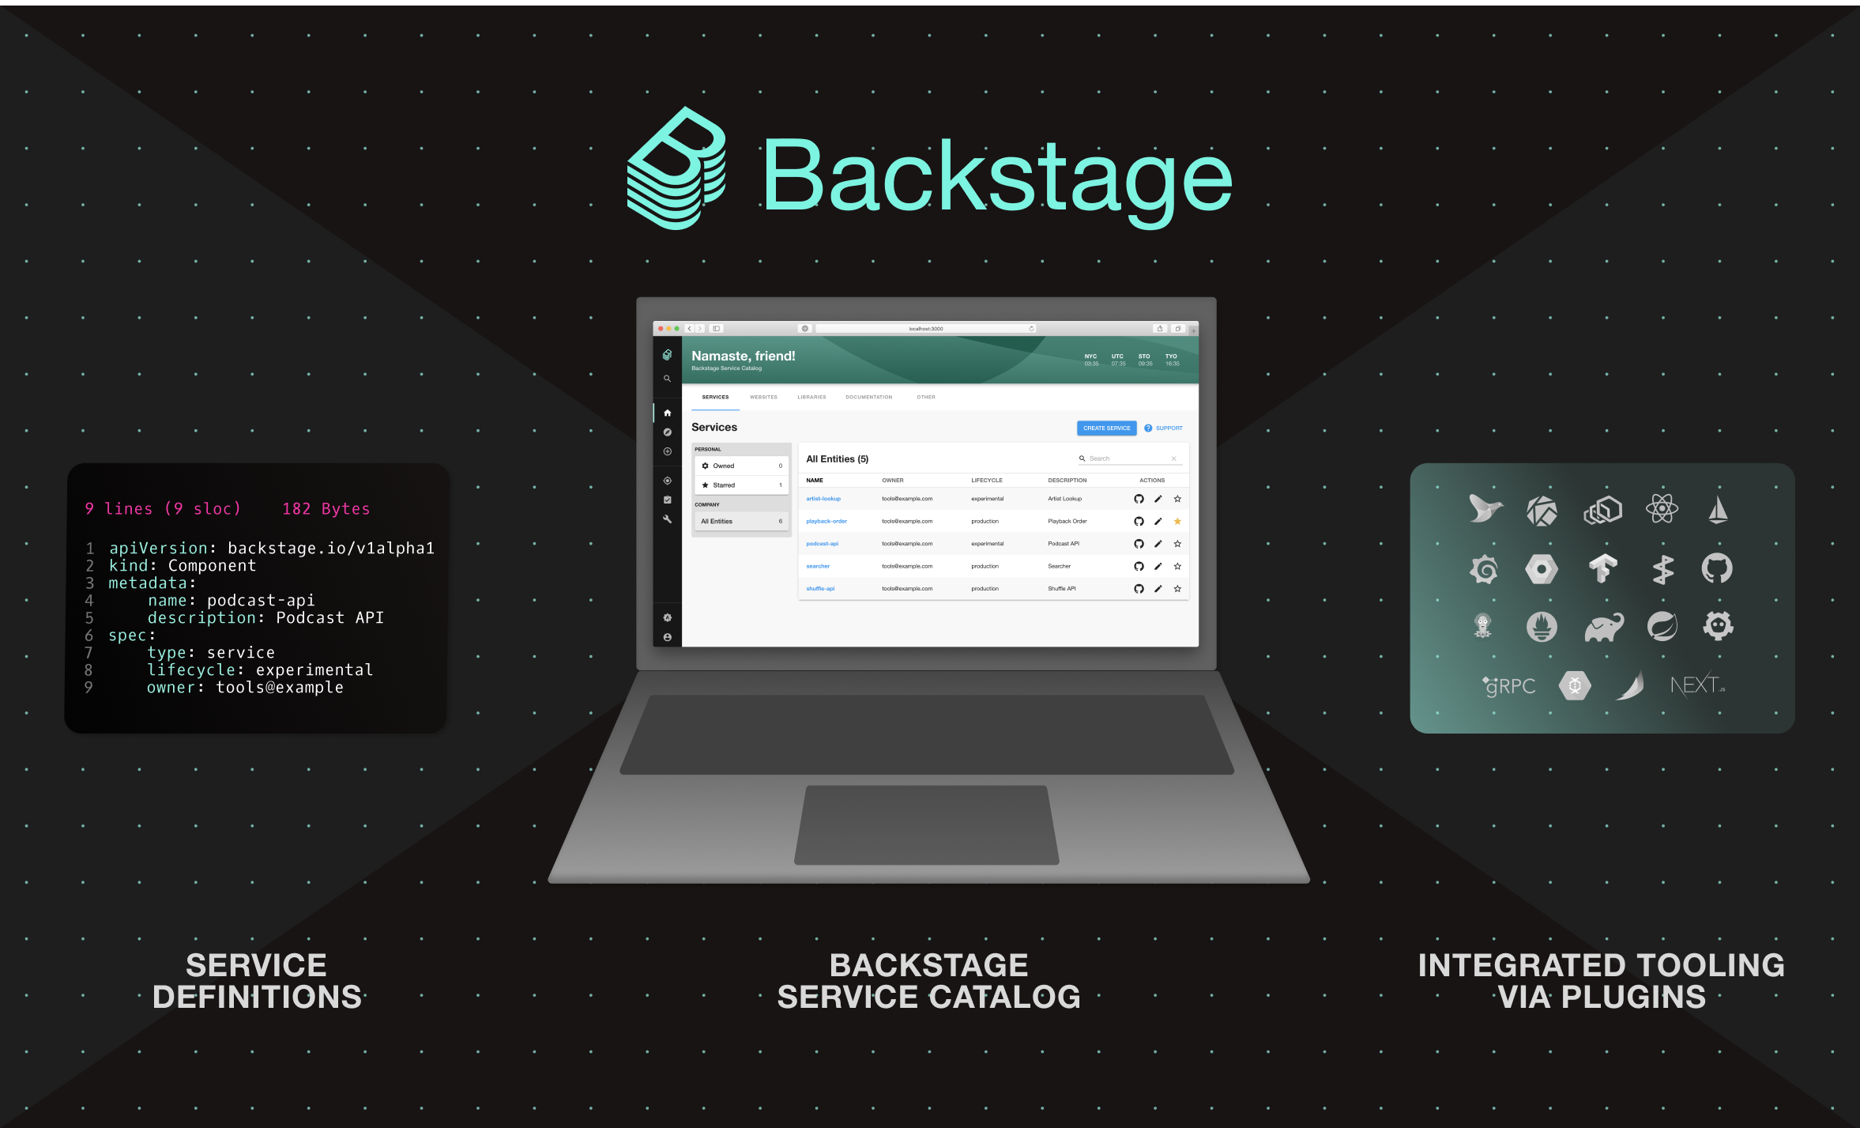
Backstage Overview
Backstage is an open platform for building developer portals.
Backstage Software Catalog for managing all your software (microservices, libraries, data pipelines, websites, ML models, etc.)
Backstage Software Templates for quickly spinning up new projects and standardizing your tooling with your organization’s best practices
Backstage TechDocs for making it easy to create, maintain, find, and use technical documentation, using a "docs like code" approach
Plus, a growing ecosystem of open source plugins that further expand Backstage’s customizability and functionality

Slide 4
Infrastructure Deployment
You need to have an valid AWS account and terraform installed base on your operating system:
https://developer.hashicorp.com/terraform/tutorials/aws-get-started/install-cli
Then you follow the documents to bring up the system:
Build the system: https://github.com/hieutnbk2011/backstage-demo/blob/main/docs/build_infra.md
Build the docker image: https://github.com/hieutnbk2011/backstage-demo/blob/main/docs/build_image.md

Slide 5
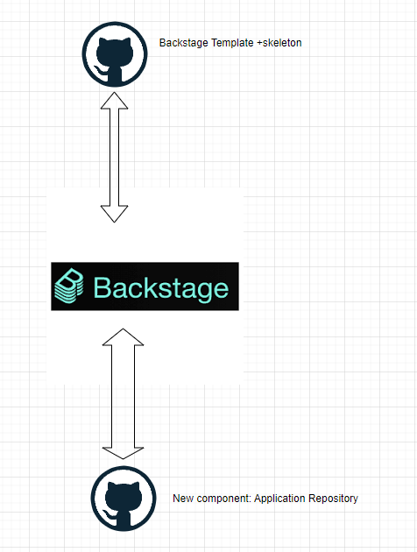
Demo
Features:
Repo created.
Github CICD action plugin.

